Slide 1

Order Changes
jBilling Academy

Slide 3
Order Statuses – Why to we need
TO MAKE THE ORDER STATUSES DYNAMICALLY CONFIGURABLE.
TO BE ABLE TO CREATE NEW ORDER STATUSES AS NEEDED

Slide 4
Order Statuses – Old
Predefined set of order statuses.
Active | When order is considered to be invoiced
Finished | When order has finished invoicing for all of its period (in the case of a recurring order)
Suspended | When order is suspended for by the user itself
Suspended Ageing | Used by the ageing process to suspend all the orders of a user who himself is getting suspended by the ageing process

Slide 5
Order Statuses – New
Configurable order statuses – Flags
Flag | Minimum statuses | Maximum statuses | Editable | Assignable
Invoice | 1 | no limit | Yes | Yes
Not Invoice | 1 | no limit | Yes | Yes
Finished | 1 | 1 | No | Yes
Ageing Suspended | 1 | 1 | No | No

Slide 6
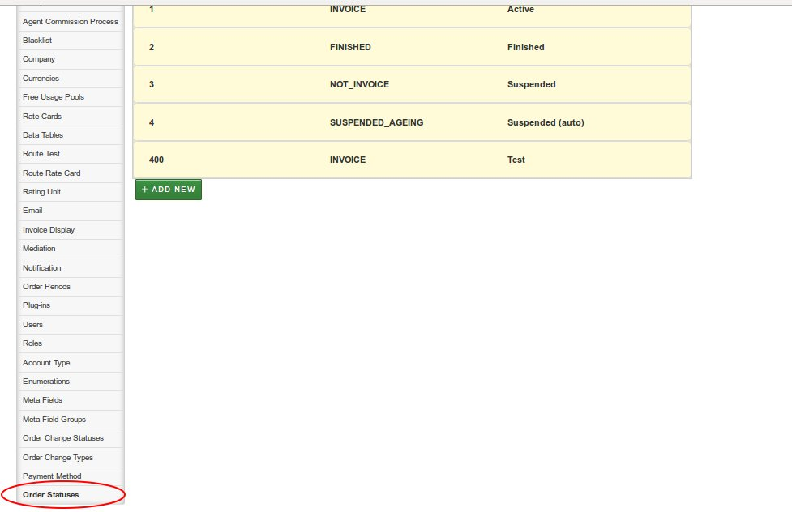
Order Statuses – Configuration

Slide 7
Order Changes – Why do we need
TO ADD/REMOVE/CHANGE PRODUCT/PLAN TO AN ORDER LINE ON A FUTURE DATE.
TO TRACK THE ORDER LINE CHANGES DONE IN THE ORDER.

Slide 8
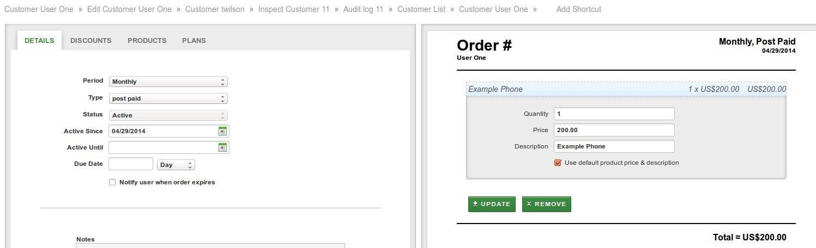
Order Lines – Old
When a product/plan is added to an order, an order line is immediately created and rated.

Slide 9
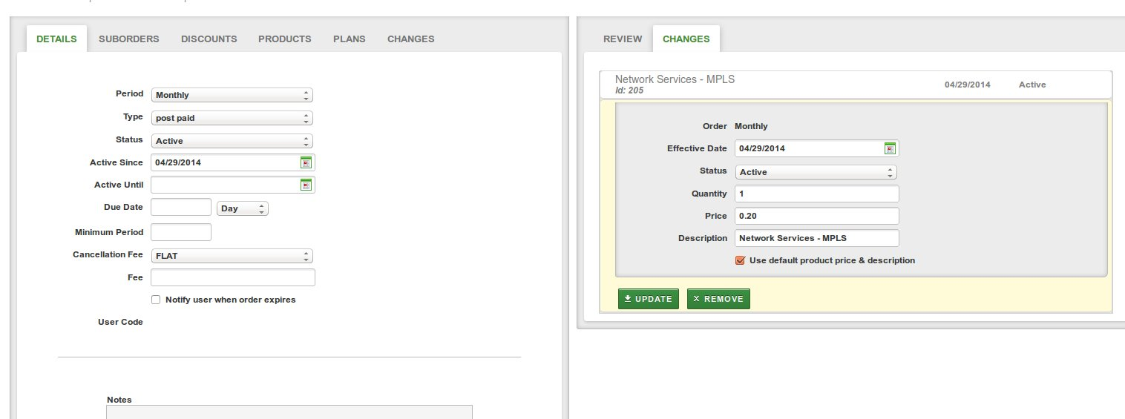
Order Changes – New
When a product/plan is added to an order, an order change is created with the product and 2 new fields: effective date and status.

Slide 10
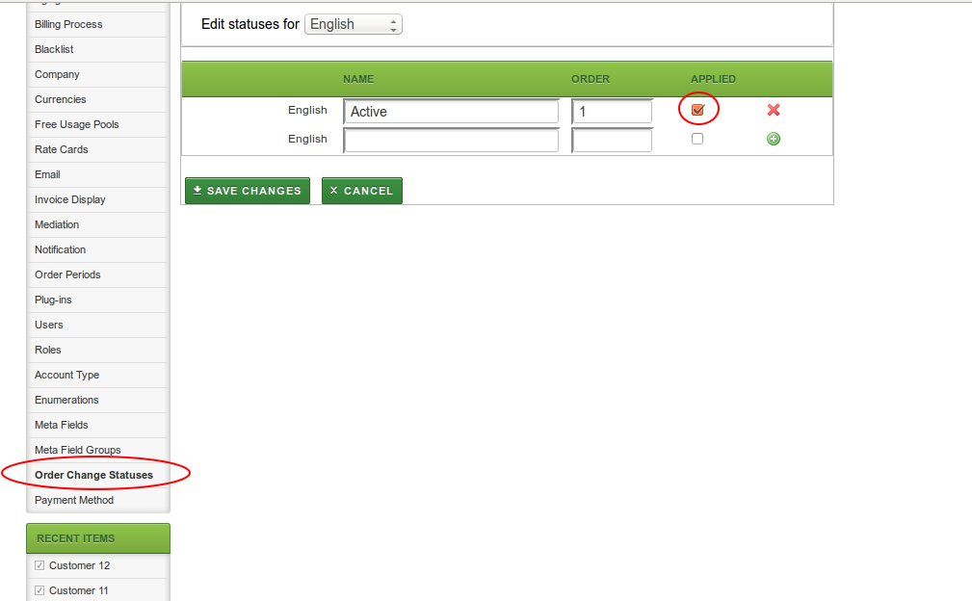
Order Changes Statuses
Configurable list of order change statuses. The status has a flag to determine whether the order change needs to be applied to the order when it reaches that status.

Slide 11
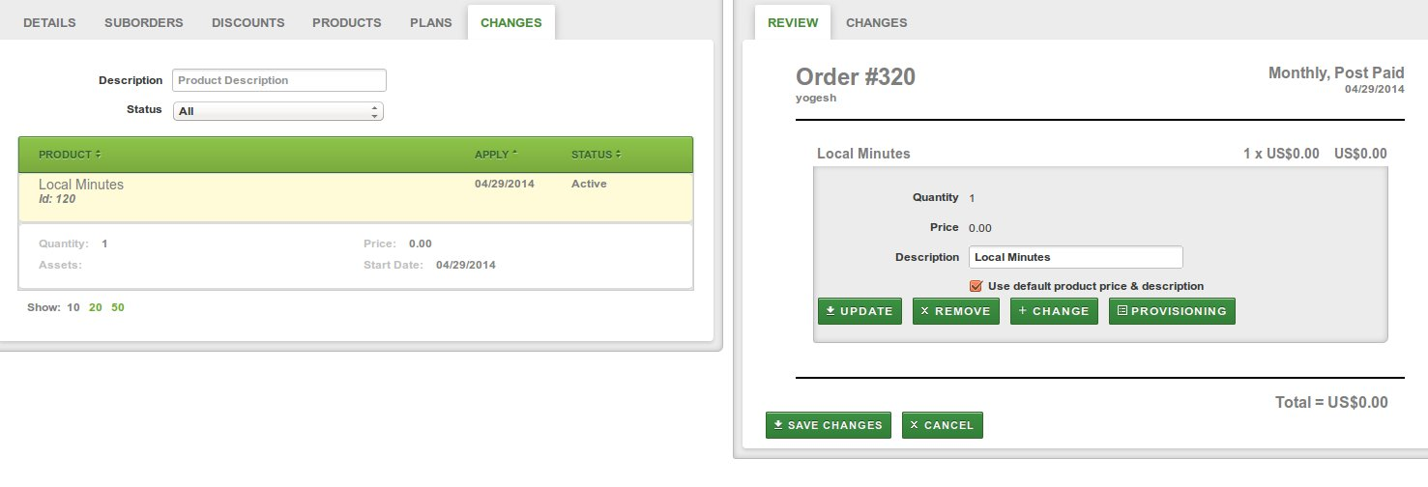
Order Changes Applied
When an order change reaches the “APPLIED” status and the effective date has passed, the corresponding order line is added/modified/deleted on order save.
A list of order changes is displayed for the order.

Slide 12
Order Changes Events & Plugins
IScheduledTask : OrderChangeUpdateTask – cron scheduler that evaluates all order changes and determines which ones need to be applied to their orders based on their statuses and effective date.
OrderChangeAppliedEvent – event fired when the order change is applied to an order.
OrderChangeStatusTransitionEvent - event fired when the order change status for particular order change is modified.

Slide 13
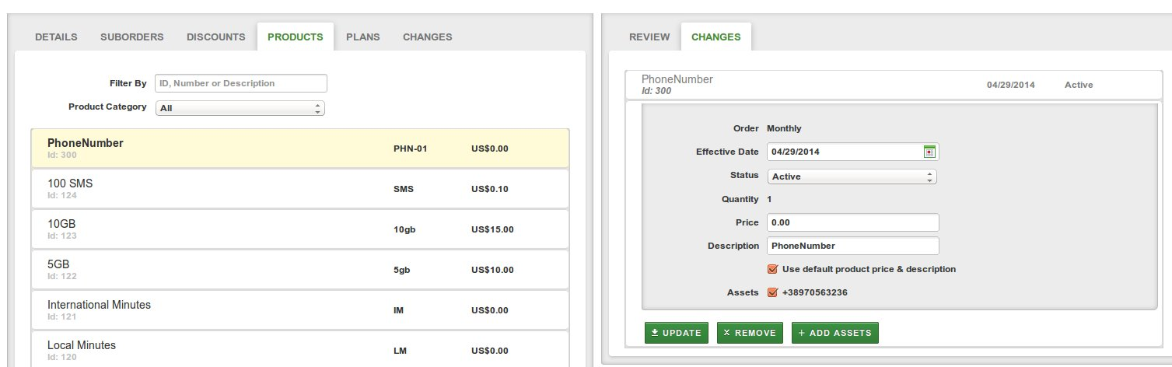
Order Changes - Assets
Order Changes also works with products that allow asset management. When the order change with asset is applied, the order line is created/updated with the asset from the order change.

Slide 14
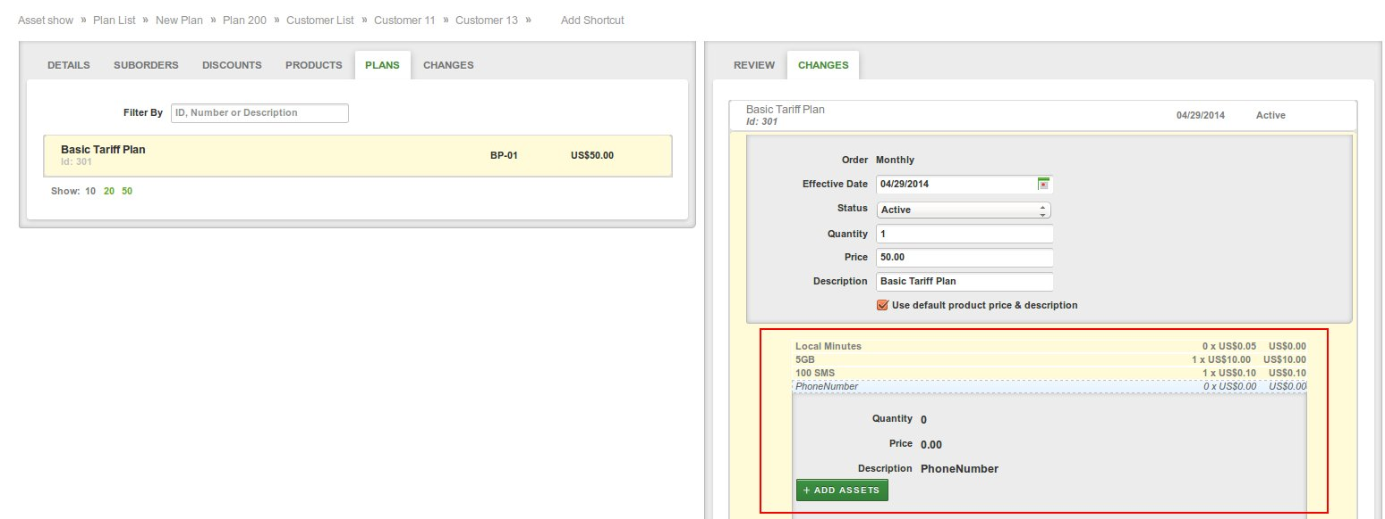
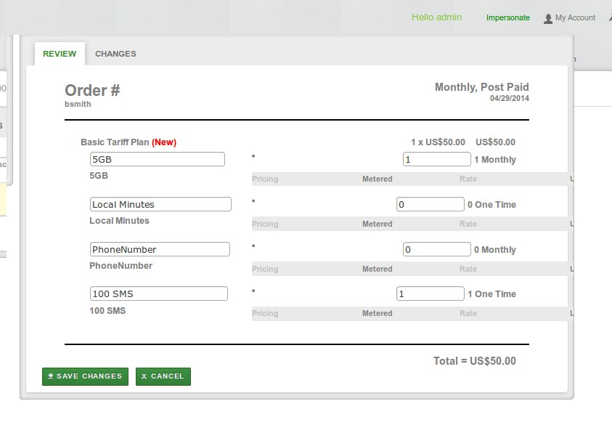
Order Changes - Plans
Order Changes allows for adding plans containing bundled items to the order.

Slide 15
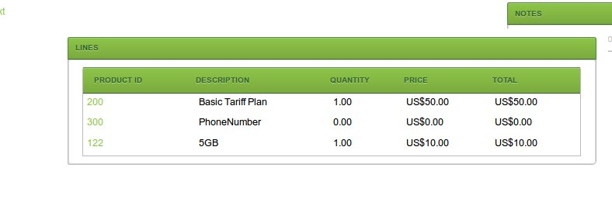
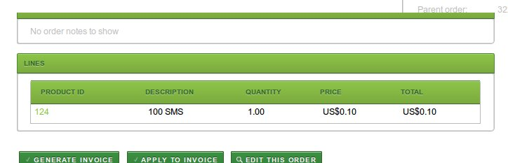
Order Changes Applied - Plans
When an order change containing a plan is applied, new child order will be created for the bundled items that have different period than the original order period.

Slide 16
Order Changes - Provisioning
The provisioning commands can be sent when an order change status has transited to a new status.
This is done by handling the OrderChangeStatusTransitionEvent in a AbstractProvisioningTask implementation (Ex. OrderLineProvisioningTask)
When the provisioning command is successfully processed, the order change that triggered that command is applied to the order (by updating its status to APPLY)

Slide 17
Order Change Type (telco only)
TO CAPTURE DIFFERENT DATA SET PER ORDER CHANGE
TO MODIFY THE ORDER STATUS WHEN THE ORDER CHANGE IS APPLIED
TO TRIGGER DIFFERENT ACTIONS

Slide 18
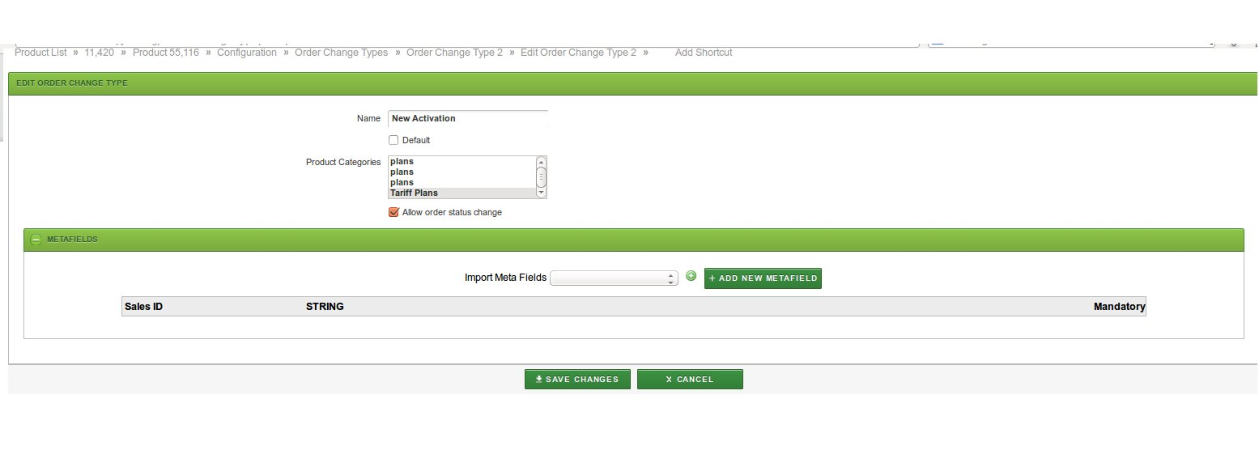
Order Change Type - Configuration
The Order Change Types can be configured in the Configuration – Order Change Type menu.

Slide 19
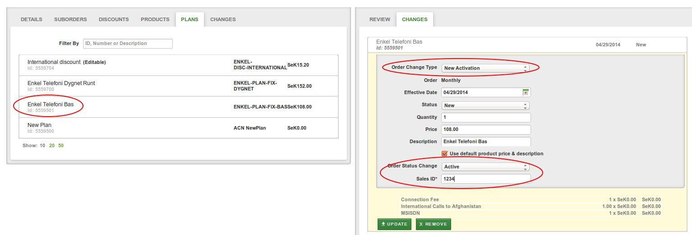
Order Change Type - Usage
The order change types are used when a new order change is created. In that case a list of all available order change types for the selected product / plan will be presented.

Slide 20
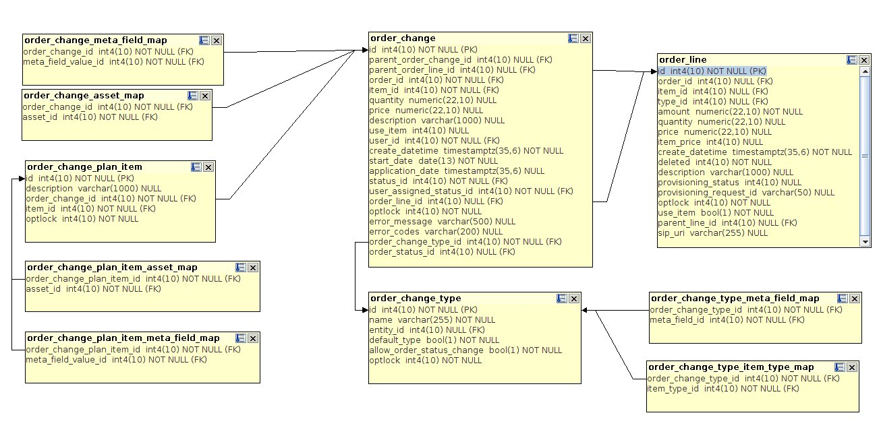

Slide 23

Notes:
<number>

Slide 24
jThank you!
Notes:
<number>

